Slide 1
Data Structure and Algorithm DS-Lec-12-13: Tree

Slide 2
Discussed So far
Here are some of the data structures
we have studied so far:
Arrays
Stacks, Queues and deques
Linked list
Inherently uni-dimensional in structure

Slide 3
Tree
A tree is defined as a finite set of one or
more nodes such that
[a] There is a specially designated
node called the root and
[b] The rest of the nodes could be partitioned into t disjoint sets (t >0) each set representing a tree T_{i}, i=1,2, .
t known as subtree of the tree.

Slide 4
Tree
A node in the definition of the tree represents an item of information, and the links between the nodes termed as Branches represent an association between the items of information.

Slide 5
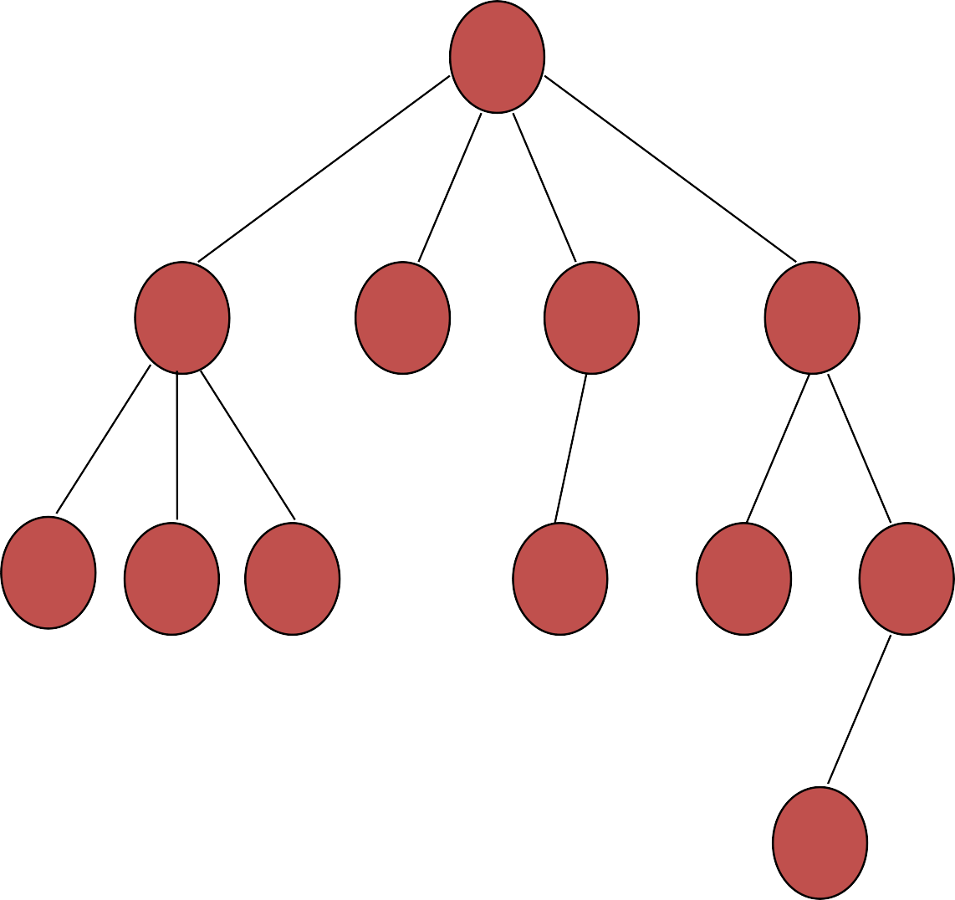
A
Level 1
 | Level 2
B
C
D
E
F
G H
I
J
K
Level 3
L
Level 4

Slide 6
Basic terminologies
degree of the node
leaf nodes or terminal nodes
non terminal nodes
children
siblings
ancestors
degree of a tree
hierarchical structure
height or depth of a tree
forest

Slide 7
Tree Terminology
A tree consists of a collection of elements or nodes, with each node linked to its successors
The node at the top of a tree is called its root
The links from a node to its successors are called branches
The successors of a node are called its children

Slide 8
Tree Terminology (continued)
Each node in a tree has exactly one parent except for the root node, which has no parent
Nodes that have the same parent are siblings
A node that has no children is called a leaf node
A generalization of the parent-child relationship is the ancestor-descendent relationship

Slide 9
Tree Terminology (continued)
The predecessor of a node is called its
Parent
A subtree of a node is a tree whose
root is a child of that node
The level of a node is a measure of its distance from the root
10

Slide 10
Tree Terminology (continued)
Node: stores the actual data and links
to other nodes
Parent: immediate predecessor of a node
Root: specially designated node which
has no parent
Child:immediate successor of a node.

Slide 11
Tree Terminology(continued)
Leaf: node without any child
Level: rank of the hierarchy and root node has level zero(0). Node at level i has the level i+1 for its child and i-1 for its parent. This is true for all nodes except the root

Slide 12
Tree Terminology (continued)
Height (depth): Maximum number of nodes possible in a path starting from root node to leaf node. Height of a tree is the maximum level of the tree.
Degree of the Node: Maximum number of the children possible for a node.
Siblings: Nodes having the same parent

Slide 13
Tree Terminology
Ancestor of a Node: Those nodes that occur on the path from the root to the given node
Degree of a Tree: Maximum degree of
the node in the tree
Forest : A set of Zero or more Disjoint trees.

Slide 14

Degree of the tree = 4 (Max degree of A)
A
Level 1
B
C
D
E
Level 2
F
G H
I
J
K
Level 3
Height of the tree = 4
(Max level)
L
Level 4

Slide 15
Representation of a tree
List Representation
(A (B(F,G,H), C, D(I), E(J,K(L))) )
For the tree Considered in the Example
Linked List Representation

Slide 16
DATA | LINK 1 | LINK 2 | … | LINK n
(a) General node structure
T
A
B
C
D
E
F
G
H
I
J
K
L
(b) Linked list representation of the tree

Slide 17
Binary Trees
A binary tree T is defined as a finite set of elements called nodes such that
[a] T is empty (Called the Null tree or Empty tree) or
[b] T contains a distinguished node R called the root of T and the remaining nodes of T form an ordered pair of disjoint binary trees T₁ and T₂
20

Slide 18
Binary Trees
A binary tree has the characteristic of all nodes having at most two branches, that is, all nodes have a degree of at most 2.
A binary tree can therefore be empty or consist of a root node and two disjoint binary trees termed left subtree and right subtree.

Slide 19
A
Level 1
B
C
Level 2
D
E
F
G
Level 3

Slide 20
Important observations regarding binary trees:
The maximum number of nodes on level i of a binary tree is 2^{i-1}, i>1
The maximum number of nodes in a binary tree of height h is 2^{h}-1,h>1
For any non empty binary tree, if t_{o} is the number of terminal nodes and t₂ is the number of nodes of degree 2 then t_{o}=t₂+1

Slide 21
A binary tree of height h which has all its permissible maximum number of nodes 2^{h}-1 intact is known as a full binary tree of height h
1
A
2
3
B
C
4
D
E
6
F
G
5
7

Slide 22
A binary tree with n’ nodes and height h is complete if its nodes correspond to the nodes which are numbered 1 to n (n’≤n) in a full binary tree of height h.
Height of a complete binary tree with n given by
1
A
h = ⎡log₂ (n +1)⎤
B
C
3
2
4
D
5
E
6
F

Slide 23
A complete binary tree obeys the following properties with regard to its node numbering:
[a] If a parent node has a number i then its left child has the number 2i (2i < n). If 2i > n then i has no left child.
[b] If a parent node has a number i, then its right child has the number 2i+1 (2i + 1 <n). If 2i + 1 > n then i has no right child.

Slide 24
A complete binary tree obeys the following properties with regard to its node numbering:
[c] If a child node (left or right) has a number i then the parent node has the number ⎣i /2⎦ if i ≠1. If i=1 then i is the root and hence has no parent.

Slide 25
A binary tree which is dominated solely by left child nodes or right child nodes is called a skewed binary tree or more specifically left skewed binary tree or right skewed binary tree respectively.
a
m
b
n
o
c
Left skewed
Right skewed
p
d

Slide 26
Extended Binary Tree: 2-Tree
A binary tree T is said to be 2-Tree or an extended binary tree if each node N has either 0 or 2 children.
Nodes with 2 children are called internal nodes and the nodes with 0 children are called external nodes.

Slide 27
Representation of Binary Tree
Binary tree can be represented by means of
[a] Array
[b] linked list
30

Slide 28
Representation Of Binary Trees
Array Representation
1
Sequential representation of a tree with depth d will require an array with approx 2^{d + 1}
a
2
b
4
c
10
5
d
e
f
11
1 2 3 4 5 6 7 8 9 10 11
a | b |  | c | d |  |  |  |  | e | f

Slide 29
Linked representation
T
a
b
LCHILD | DATA | RCHILD
c
d
e
f

Slide 30
Observation regarding the linked representation of Binary Tree
[a] If a binary tree has n nodes then the number of pointers used in its linked representation is 2*n
[b] The number of null pointers used in the linked representation of a binary tree with n nodes is n+1

Slide 31
Build Tree
void insert(int item) {
Node* newbie = new Node();
Node* parent = NULL;
newbie->left = NULL;
newbie->right= NULL;
newbie->data = item;
if(isEmpty()){
root = newbie;
}

Slide 32
else{
Node* ptr = root;
while(ptr != NULL){
parent = ptr;
if(item > ptr->data){
ptr = ptr->right;
}
else if(item < ptr->data){
ptr = ptr->left;
}
else
cout << "This object already exists in the tree!"<< endl;
if(item > parent->data ){ //put on the right
parent->right = newbie;
}
if(item < parent->data ){ //put on the left
parent->left = newbie;
} }}

Slide 33
Traversing Binary Tree
Three ways of traversing the binary tree T with root R
Preorder
[a] Process the root R
[b] Traverse the left sub-tree of R in preorder
[c] Traverse the right sub-tree of R in preorder
a. k. a node-left-right traversal (NLR)

Slide 34
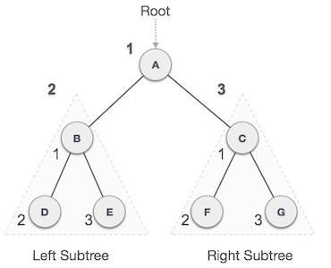
Pre-order Traversing
In this traversal method, the root node is visited first, then the left subtree and finally the right subtree.
Until all nodes are traversed −
Step 1 − Visit root node.
Step 2 − Recursively traverse left subtree.
Step 3 − Recursively traverse right subtree.
We start from A, and following pre-order traversal, we first visit A itself and then move to its left subtree B. B is also traversed pre-order. The process goes on until all the nodes are visited. The output of pre-order traversal of this tree will be −
A → B → D → E → C → F → G

Slide 35
Programming Code for preorder
void BinaryTree::printPreorder(BinaryTree *node)
{
if (node == NULL)
return;
cout << node->data << " ";
printPreorder(node->left);
printPreorder(node->right);
}
Until all nodes are traversed −
Step 1 − Visit root node.
Step 2 − Recursively traverse left subtree.
Step 3 − Recursively traverse right subtree.

Slide 36
Traversing Binary Tree
In-order
[a] Traverse the left sub-tree of R in inorder
[b] Process the root R
[c] Traverse the right sub-tree of R in in- order
a. k. a left-node-right traversal (LNR)

Slide 37
In-order Traversing
In this traversal method, the left subtree is visited first, then the root and later the right sub-tree. We should always remember that every node may represent a subtree itself.
If a binary tree is traversed in-order, the output will produce sorted key values in an ascending order.
Until all nodes are traversed −
Step 1 − Recursively traverse left subtree.
Step 2 − Visit root node.
Step 3 − Recursively traverse right subtree.
We start from A, and following in-order traversal, we move to its left subtree B. B is also traversed in-order. The process goes on until all the nodes are visited. The output of inorder traversal of this tree will be −
D → B → E → A→ F → C → G

Slide 38
Programming Code for inorder
void BinaryTree::printInorder(BinaryTree *node)
{
if (node == NULL)
return;
printInorder(node->left);
cout << node->data << " ";
printInorder(node->right);
}

Slide 39
Traversing Binary Tree
Post-order
[a] Traverse the left sub-tree of R in post-order
[b] Traverse the right sub-tree of R in postorder
[c] Process the root R
a. k. a left-right-node traversal (LRN)

Slide 40
Post-order Traversing
In this traversal method, the root node is visited last, hence the name. First we traverse the left subtree, then the right subtree and finally the root node.
Until all nodes are traversed −
Step 1 − Recursively traverse left subtree.
Step 2 − Recursively traverse right subtree.
Step 3 −Visit root node.
We start from A, and following Post-order traversal, we first visit the left subtree B. B is also traversed post-order. The process goes on until all the nodes are visited. The output of post-order traversal of this tree will be −
D → E → B → F → G → C → A

Slide 41
Programming Code for postorder
void BinaryTree::printPostorder(BinaryTree *node)
{
if (node == NULL)
return;
printPostorder(node->left);
printPostorder(node->right);
cout << node->data << " ";
}

Slide 42
Tree Traversal
There are basically three ways of binary tree traversals.
1. Inorder --- (left child,root,right child)
2. Preorder --- (root,left child,right child)
3. Postorder --- (left child,right child,root)

Slide 43
APPLICATIONS
1. Some applications of preorder traversal are the evaluation of expressions in prefix notation and the processing of abstract syntax trees by compilers.
2. Binary search trees (a special type of BT) use inorder traversal to print all of their data in alphanumeric order.
3. A popular application for the use of postorder traversal is the evaluating of expressions in postfix notation.

Slide 44
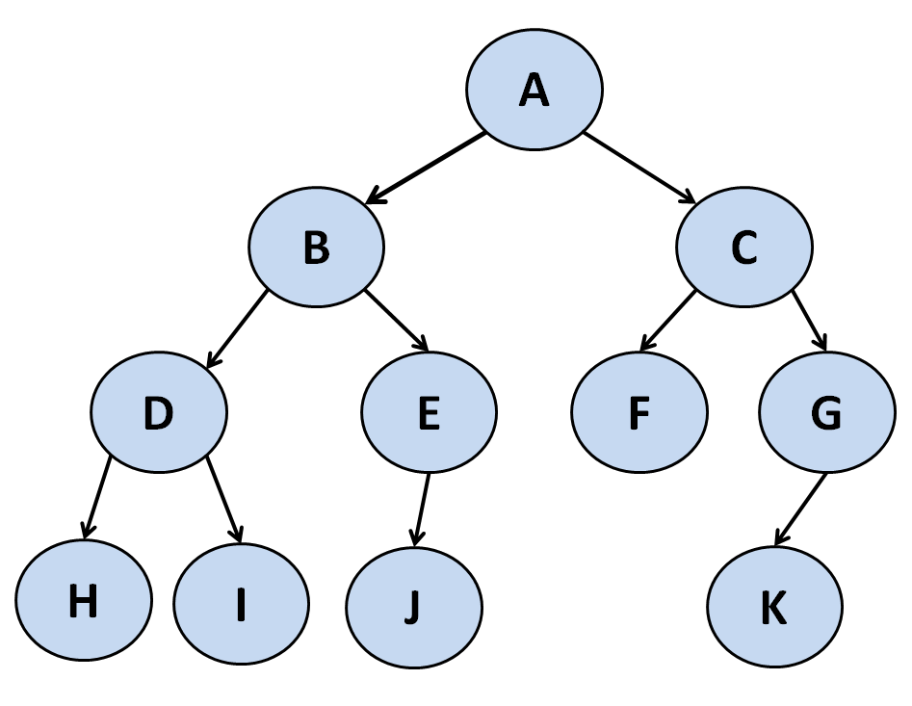
Illustrations for Traversals
Assume: visiting a node is printing its label
Preorder:A,
Inorder:
Postorder:

Slide 45
Illustrations for Traversals
Assume: visiting a node is printing its info
Preorder: A B D H I E J C F G K
Inorder: H D I B J E A F C K G
Postorder: H I D J E B F K G C A

Slide 46
Formulation of Binary tree from Its traversal
If preorder is given=>First node is the root
If postorder is given=>Last node is the root
Once the root node is identified, all nodes in the left subtrees and right subtrees of the root node can be identified.
Same technique can be applied repeatedly to form subtrees

Slide 47
4.Two traversals are essential out of which one should inorder, another may be preorder or postorder
5. But we can’t form a binary tree if only preorder
and postorder has given.
40

Slide 48
Example: For Given Inorder and Preorder
Inorder: D B H E A I F J CG
Preorder: A B D E H C F I J G
Now root is A
Left subtree: D B H E
Right subtree: I F J C G

Slide 49
continues.
A
In:D B H E Pre:B D E H
I F J C G C F I J G
D
H E
E H
I F J
F I J
G
I
J
H

Slide 50
Example: For Given Inorder and Postorder
Inorder: n1,n2, n3, n4, n5, n6, n7, n8, n9
Postorder: n1,n3, n5, n4, n2, n8, n7, n9, n6
So here n6 is the root

Slide 51
n6
In:n1,n2,n3,n4,n5
Post:n1,n3,n5,n4,n2
n7,n8,n9
n8,n7,n9
n1
n3,n4,n5
n7,n8
n3,n5,n4
n8,n7
n3
n5
n8

Slide 52
Inorder And Preorder
inorder = g d h b e i a f j c
preorder = a b d g h e i c f j
Scan the preorder left to right using the inorder to separate left and right subtrees.
a is the root of the tree; gdhbei are in the left subtree; fjc are in the right subtree.
a
gdhbei
fjc

Slide 53
Inorder And Preorder
a
gdhbei
fjc
preorder = a b d g h e i c f j
b is the next root; gdh are in the left subtree; ei are in the right subtree.
a
b
fjc
gdh
ei

Slide 54
Inorder And Preorder
a
b
fjc
gdh
ei
preorder = a b d g h e i c f j
d is the next root; g is in the left subtree; h is in the right subtree.
a
b
fjc
d
ei
g
h

Slide 55
Inorder And Postorder
Scan postorder from right to left using inorder to separate left and right subtrees.
inorder = g d h b e i a f j c
postorder = g h d i e b j f c a
Tree root is a; gdhbei are in left subtree; fjc are in right subtree.

Slide 56
Traversal Algorithm Using Stack
Assumption
Binary Tree is represented by
TREE(INFO, LEFT, RIGHT, ROOT)
A variable PTR (pointer) will contain the location of the node N currently being scanned. An array STACK will hold the addresses of the node for future processing

Slide 57
Pre-Order Traversal
[1] [ Initially push NULL onto STACK and initialize PTR]
Set TOP =1, STACK[1] = NULL and PTR = ROOT
[2] Repeat Steps 3 to 5 while PTR !=NULL
[3] Apply PROCESS to PTR->INFO
[4] [Right Child ?]
If PTR -> RIGHT !=NULL, then [Push on STACK]
SET TOP = TOP + 1, STACK[TOP] = PTR->RIGHT
[5] [Left Child ?]
If PTR->LEFT !=NULL, Then
Set PTR = PTR->LEFT
Else
Set PTR = STACK[TOP], TOP = TOP-1
[6] Exit

Slide 58
Pre-Order Traversal
A
B C
E F
D
G
H
K

Slide 59
[1] Initially push NULL onto STACK STACK = φ
Set PTR = A , the root of T
[2] Proceed down the left-most path rooted at
PTR = A as follows
Process A and Push its right child C onto STACK.
STACK: φ, C
Process B. (There is no Right Child)
Process D and push its Right Child H onto STACK. STACK: φ, C, H
Process G (There is no right child)

Slide 60
[3] [Backtracking] Pop the top element H from STACK, and set PTR = H
STACK: φ, C
[4] Proceed down the left-most path rooted at PTR =H as follows
(v) Process H and Push its right child K onto STACK:
STACK: φ, C, K
[No other node is processed, since H has no left child]
[5] [Backtracking] Pop the top element K from STACK, and set
PTR = K
STACK: φ, C
50

Slide 61
[6] Proceed down the left-most path rooted at PTR = K as follows
Process K. (There is no right child)
[No other node is processed, since K has no left child] [7]
[Backtracking] Pop the top element C from STACK,
and set PTR = C
STACK: φ
[8] Proceed down the left-most path rooted at PTR = C
as follows
Process C and push its right child F onto STACK.
STACK: φ, F
Process E (There is no right child)

Slide 62
[9] [Backtracking] Pop the top element F
from STACK, and set PTR = F
STACK: φ
[10] Proceed down the left-most path
rooted at PTR = F as follows
(ix) Process F. (There is no right child)
[No other node is processed, since F has
no left child]
[11] [Backtracking] Pop the top element
NULL from STACK, and set PTR = NULL

Slide 63
In-order Traversal
[1] [Push NULL onto STACK and initialize PTR]
Set TOP =1, STACK[1] = NULL, PTR = ROOT
[2] Repeat while PTR != NULL
[Pushes the Left-most path onto STACK]
Set TOP = TOP + 1, STACK[TOP] = PTR
Set PTR = PTR -> LEFT
[3] Set PTR = STACK[TOP], TOP = TOP -1
[Pops node from STACK]

Slide 64
In-order Traversal
[4] Repeat Steps 5 to 7 while PTR!=
NULL: [Backtracking]
[5] Apply PROCESS to PTR->INFO
[6] [Right Child ?] If PTR->RIGHT  NULL then
Set PTR = PTR->RIGHT
Go to Step 2
[7] Set PTR = STACK[TOP], TOP = TOP -1
[8] Exit

Slide 65
In-Order Traversal
A
B C
D
E
G
K L
H
M

Slide 66
[1] Initially Push NULL onto STACK
STACK = φ
Set PTR = A , the root of T
[2] Proceed down the left-most path rooted at PTR = A, pushing the nodes A, B, D, G and K onto STACK:
STACK = φ, A, B, D, G, K
[3] [Backtracking] The nodes K, G and D are popped and processed
STACK = φ, A, B
Set PTR = H [Right Child of D]
[4] Proceed down the left-most path rooted at PTR = H, pushing the nodes H and L onto STACK:
STACK = φ, A, B, H, L

Slide 67
[5] [Backtracking] Nodes L and H are popped and processed
STACK = φ, A, B
Set PTR = M, the Right child of H
[6] Proceed down the left-most path rooted at
PTR = M, pushing node M onto STACK
STACK = φ, A, B, M
[7] [Backtracking] Nodes M, B and A are popped and processed
STACK = φ
Set PTR = C, the Right child of A

Slide 68
[8] Proceed down the left-most path rooted at PTR = C, pushing node C and E onto STACK
STACK = φ, C, E
[9] [Backtracking] Nodes E and C are popped and processed.

